Slide 1
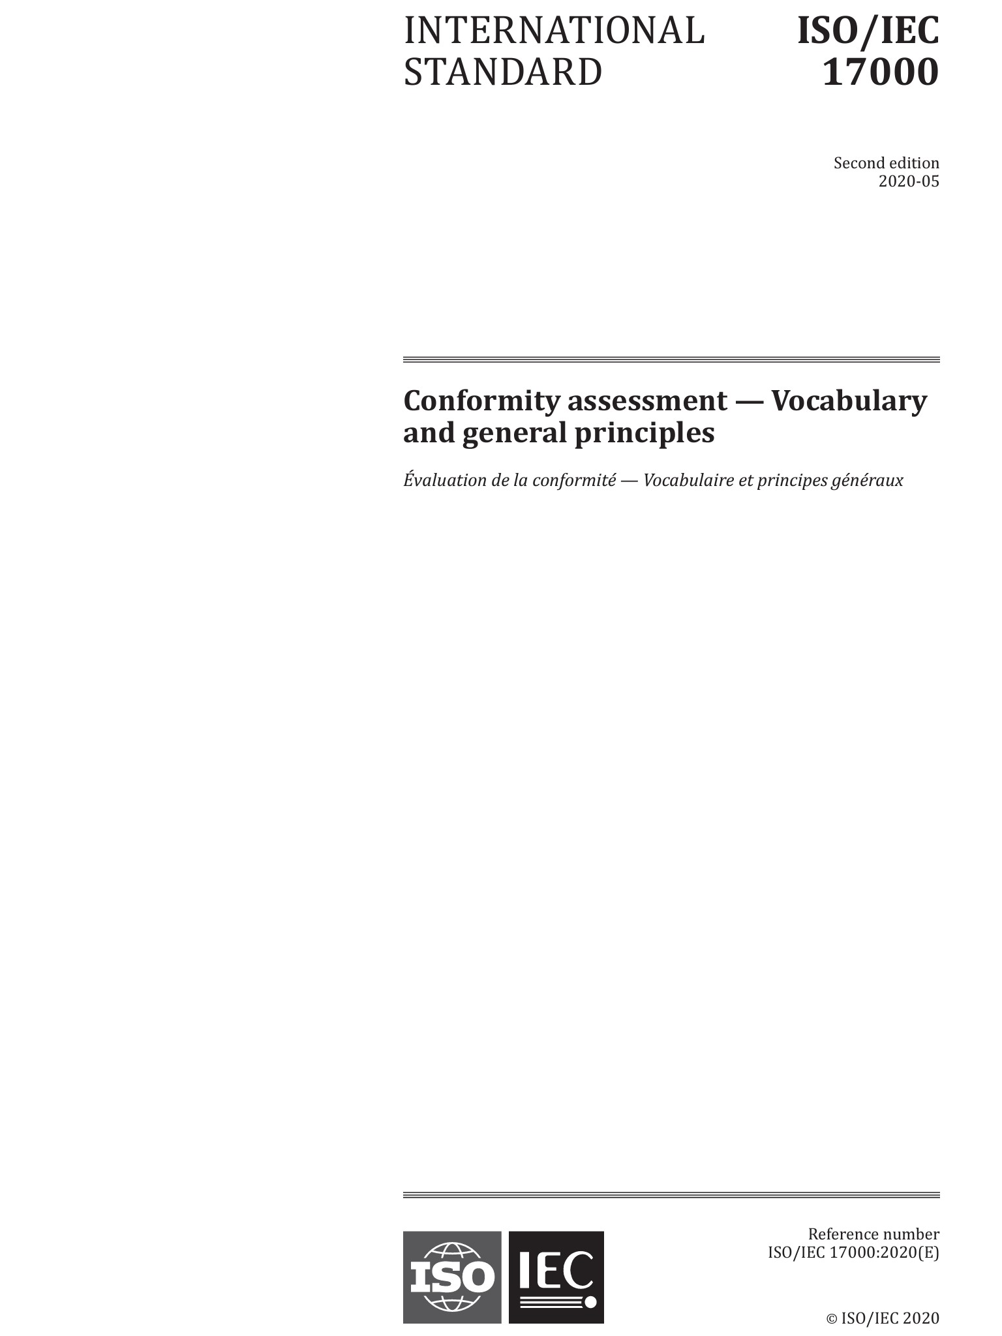

ISO/IEC 17000 Conformity Assessment – Vocabulary and general principles

Slide 2

Introduction
This presentation has been developed by the Co-Convenor of ISO CASCO WG49.
The aim is to support all interested parties concerned by the implementation of this new standard, ISO/IEC 17000: 2020 Conformity assessment – Vocabulary and general principles.
This is an open presentation and may be used by anyone.
Cynthia D. Woodley
ISO CASCO WG49 Co-Convenor

Slide 3
Purpose of 17000
ISO/IEC 17000 contains conformity assessment terminology intended to be used by all the ISO/IEC 17000 series of standards
The standard provides a consistent framework within which conformity assessment concepts are defined.
Terms consistent with all ISO/IEC 17000 standards and not the dictionary definition are included.
Specific terms related only to a specific standard are defined in the specific standard and not in this standard.
ISO/IEC 17000 describes the functional approach to conformity assessment

Slide 4

Background Information
ISO/IEC 17000 was originally published in 2004
New Work Item Proposal (NWIP) balloted 23 December 2016 – 27 March 2017.
Purpose of the NWIP was to update the existing definition text in the standard and add any needed concepts, terms and definitions without altering the underlying concept system or current terms in order to take into account:
Updated terminology reflected in ISO 9000: 2015, Annex SL of the ISO/IEC directives (high level structure), and other conformity assessment standards (ISO/IEC 17024, ISO/IEC TS 17027)
Development of new conformity assessment standards that have new terms that need to be added to ISO/IEC 17000
Technological advances that may result in new terms and/or change existing definition text
Discussions reflecting developments in the CASCO toolbox resulting in new terms or changes in definition text
Changing modes of business operations in the conformity assessment sector
Terms that have different meaning for different circumstances

Slide 5
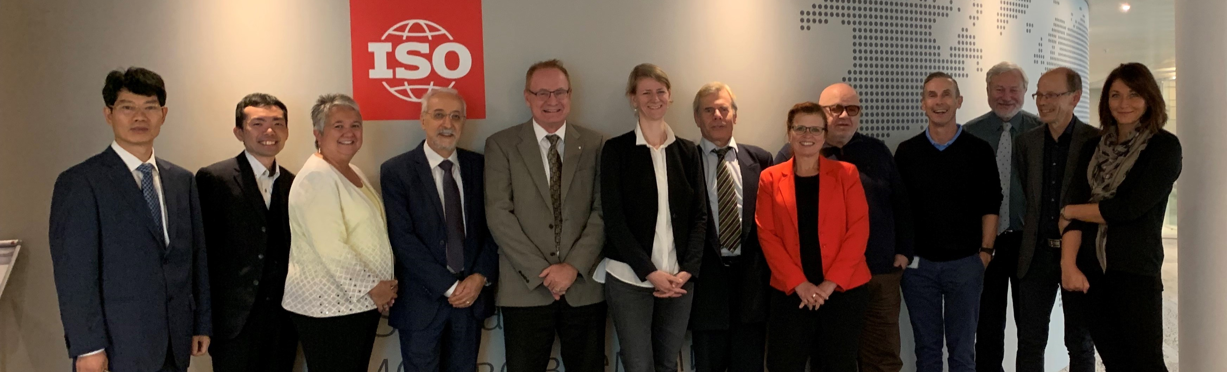
WG49 formed
ISO CASCO Co-Convenors WG49
Cynthia D. Woodley
Dandan Zheng
51 Members from member bodies
7 Members from liaison bodies

Slide 6

Restrictions in the NWIP
NWIP - Only the following revisions:
adding terms to ISO/IEC 17000 that are unique to only one or several subfields of conformity assessment (previously terms had to be common across ALL 17000 series standards)
Revised text of current definitions in ISO/IEC 17000 with the constraint that any revised definition text will NOT alter the underlying concept system for ISO/IEC 17000. Existing terms will continue to be used for their underlying concept.
Additions to the underlying concept system for ISO/IEC 17000 and additional corresponding terms and definition text for those additional concepts.

Slide 7
Development stages
Mar. 2017
New Work Item Proposal (NWIP) to revised ISO/IEC 17000:2004 approved.
Creation of the Working Group 49 (WG49).
June 2017
1st WG49 meeting
Scope, methodology and rules for revision agreed, given the specific boundaries of revision.
Structure of the future draft confirmed.
Sep. 2017
2nd WG49 meeting
Development of the Working Draft 1(WD1).
Oct.–Dec. 2017
WG consultation on WD1.
Feb. 2018
3rd WG49 meeting
Development of the Committee Draft (CD) and need to update some parts of the standard, not initially included in the scope of revision.
June/Aug. 2018
Extension of scope to 4 specific items approved during the Committee Internal Ballot (CIB) in June.
CD with extended scope approved in August.
Nov. 2018
4th WG49 meeting
Development of the Draft International Standard(DIS)
June 2019
DIS approved in ISO and IEC but rejected in CEN.
September 2019
5th WG49 meeting
Resolution of DIS comments and preparation of the Final Draft International Standard (FDIS)
March 2020
FDIS approved in ISO, IEC and CEN
May 2020
Publication of ISO/IEC 17000: 2020
Notes:
The process started with a preliminary research and took in total three years and a half.

Slide 8

Foundation for the Standard – Concept mapping of terms
WG used the first meeting to visually map out the major terms and how they relate to one another.

Slide 9
ISO/IEC 17000:2020 CONCEPT MAPS* *Thank you to Keith Mowry of UL LLC for creating these.

Slide 10

Concepts for 17000
A dictionary captures the meaning of words as used at the time the dictionary is published. As noted in Merriam-Webster’s New Collegiate Dictionary, 1981:
“Like other human institutions, a language is adjusted by long use to the particular needs of the people and society that use it. When these needs change the language also changes, usually much more rapidly than most other institutions.”
Such change drives the need for new dictionaries to capture the current meaning of words in a language.
ISO/IEC 17000 is not a dictionary. It does not seek to define the meaning of words based on their use in day to day interactions. The revision of ISO/IEC 17000 was not undertaken to reflect how the meaning of certain words has evolved since the original publication of the Standard in 2004.

Slide 11
ISO/IEC 17000
ISO/IEC 17000 is a terminology document – a document that identifies and defines concepts specific to the field of conformity assessment in a manner that provides specificity for each concept and an indication of the relationships between the concepts. With the specificity and the relationship between concepts known, the terms for the concepts can be used to produce standards in the field of conformity assessment which are clear. Such standards are thus suitable for reference in contracts, legislation, regulation or other documents where clarity of requirements, obligations, rights, responsibilities, etc. is essential.

Slide 12

Concept Map Background
As stipulated in the New Work Item Proposal, ISO/IEC 17000 was revised to improve the specificity of existing concepts, delete concepts no longer needed, and add new concepts without altering the relationships between existing concepts.
Concept diagrams were created in the course of drafting revisions to ensure revisions were not changing the relationships between existing concepts and to more precisely understand those relationships. Those concept diagrams are presented here to assist with understanding ISO/IEC 17000 as well as understanding conformity assessment in general.
ISO 704 Terminology work – Principles and methods was utilized to guide both the original and revision of ISO/IEC 17000. ISO 704 can be consulted for more information regarding terminologies including concepts, concept systems and concept diagrams.
Three types of relationships are used to create the diagrams of the concepts in the revised ISO/IEC 17000 (as displayed in the next 3 slides)

Slide 13
1. PART OF Relationship:
A rake type diagram is used to show concepts that are a part of another concept. For example:
Railroad
Bed
Rail
Tie
Spike
Sentence form: Rails are part of a railroad
The vertical elements of this diagram have the following meaning:
Is part of
Multiples are part of
Optionally part of
Multiples are optionally part of

Slide 14
2. TYPE OF Relationship:
A fan type diagram is used to show concepts that are a type of another concept. For example:
Sentence form: A commuter line is a type of a railroad

Slide 15
3. ASSOCIATED WITH Relationship:
Double arrows are used to show concepts that are associated with other concepts. For example:
Railroad
Locomotive
Easement
Sentence form: A locomotive is associated with a railroad.

Slide 16
Concepts in 17000
All the concepts with Terms and Definitions in ISO/IEC 17000 are part of a single concept system. Specifically, all concepts are related through one or more relationships to the top-level concept “conformity assessment”. However, for readability, the single concept system is presented in five separate diagrams with explanatory text included for each diagram.
Not every relationship between concepts is captured in the following diagrams. The relationships included are those most important for understanding ISO/IEC 17000 and understanding conformity assessment in general.

Slide 17
DIAGRAM 1 – ISO/IEC 17000 Annex A presents a representation of the concept of conformity assessment in flow chart format along with an explanation of this representation. This representation is referred to as the Functional Approach since the representation is in terms of three related functions:
Selection
Determination
Review-Decision-Attestation
The following concept diagram shows that these three functions comprise conformity assessment and thus are PART OF the concept of conformity assessment. It also shows that various concepts in conformity assessment are TYPES OF activities of one of the three functions and are ASSOCIATED WITH other concepts.

Slide 18
DIAGRAM 1
Conformity assessment
Selection function activities
(undefined – see ISO/IEC 17000, Annex A)
Determination function activities
(undefined – see ISO/IEC 17000, Annex A)
Review-Decision-Attestation function activities
(undefined – see ISO/IEC 17000, Annex A)
Testing
Inspection
Review
Sampling
Audit
Peer assessment
Decision
Validation
Attestation
(See Diagram 2)
Verification
Agreement group
Declaration
Certification
Accreditation
Accreditation body

Slide 19
DIAGRAM 2
A number of concepts are ASSOCIATED WITH the concept of “attestation”. The following concept diagram shows those relationships.
Attestation
Statement
(of conformity)
(undefined – see ISO/IEC 17000, Annex A)
Surveillance
Expiry
Scope of attestation
Withdrawal
Suspension
Restoration

Slide 20
DIAGRAM 3
As described in ISO/IEC 17000 Annex A, conformity assessment is a series of activities grouped into three functions (the Functional Approach – see Diagram 1).
ISO/IEC 17000 includes the concepts of “first party conformity assessment activities”, “second party conformity activities” and “third party conformity assessment activities”. All the activities that comprise conformity assessment will be “first party conformity assessment activities”, “second party conformity activities” or “third party conformity assessment activities” based on the following two questions and the definitions in ISO/IEC 17000:
Is the activity performed by the provider of the object?
YES – activity is a first party activity per ISO/IEC 17000
NO – activity is either a second party activity or a third party activity
Is the activity performed by a person or group with a user interest in the object?
YES – the activity is a second party activity per ISO/IEC 17000
NO – the activity is a third party activity per ISO/IEC 17000
The following concept diagram shows “first party conformity assessment activities”, “second party conformity activities” and “third party conformity assessment activities” are PART OF conformity assessment. Conformity assessment may or may not include one or more “first party conformity assessment activities”, “second party conformity activities” and “third party conformity assessment activities”.
The following concept diagram also shows that some concepts, based on their definition in ISO/IEC 17000, can be a TYPE OF all three (“first party conformity assessment activities”, “second party conformity activities” or “third party conformity assessment activities” – plain text below) while other concepts might only be a TYPE OF only one (“first party conformity assessment activities”, “second party conformity activities” or “third party conformity assessment activities” – bold text below).

Slide 21
DIAGRAM 3
Conformity assessment
First party conformity assessment activity
Second party conformity assessment activity
Third party conformity assessment activity
Sampling
Sampling
Sampling
Testing
Testing
Testing
Inspection
Inspection
Inspection
Audit
Audit
Audit
Validation
Peer assessment
Validation
Verification
Validation
Verification
Agreement group
Review
Verification
Review
Decision
Review
Decision
Declaration
Decision
Certification
Second party attestation
(undefined – see ISO/IEC 17000, Annex A)
Accreditation
Accreditation body

Slide 22
DIAGRAM 4
The following concept diagram shows general concepts ASSOCIATED WITH conformity assessment.
Conformity assessment
Participant
Person or organization
(undefined – see dictionary)
Member
Specified requirement
Owner
Independence
Object of conformity assessment
Person or organization
(undefined – see dictionary)
Conformity assessment scheme
Conformity assessment system
Impartiality
Appeal
Designation
Complaint
Body
(undefined – see ISO/IEC 17000 2.1.2, Note 2)
Access
Designation authority
Procedure
Rule
(undefined – see dictionary)
Conformity assessment body
Accreditation body

Slide 23
DIAGRAM 5
The following concept diagram shows trade-related concepts ASSOCIATED WITH conformity assessment.
Conformity assessment
Agreement group
Approval
Equivalence
Arrangement
(undefined – see dictionary )
Recognition
Acceptance
Unilateral arrangement
Multilateral arrangement
Reciprocity
Bilateral arrangement
Treatment
(undefined – see dictionary )
Equal treatment
Equal and national treatment
National treatment

Slide 24

Changes made in ISO/IEC 17000:2020

Slide 25
New Terms Added:
Object of conformity assessment/Object – entity to which specified requirements apply
Owner/Owner of a system or scheme – person or organization responsible for the development and maintenance of a conformity assessment system or conformity assessment scheme
Impartiality – objectivity with regard to the outcome of a conformity assessment activity
Independence – freedom of a person or organization form the control or authority of another person or organization
Validation – confirmation of plausibility for a specific intended use or application, through the provision of objective evidence that specified requirements have been fulfilled
Verification – confirmation of truthfulness, through the provision of objective evidence that specified requirements have been fulfilled

Slide 26
New Terms Added:
Decision – conclusion based on the results of review that fulfilment of specified requirements has or has not been demonstrated
Expiry – ending of the validity of the statement of conformity after a specified period
Restoration – reinstatement of the full or partial statement of conformity

Slide 27

Terms Modified or Deleted:
Conformity assessment system
Old: rules, procedures, and management for carrying out conformity assessment.
New: Set of common rules and procedures for the management of similar or related conformity assessment schemes.
Conformity assessment scheme
Old: conformity assessment system related to specified objects of conformity assessment, to which the same specified requirements, specific rules and procedures apply
New: set of rules and procedures that describes the objects of conformity assessment, identifies the specified requirements and provides the methodology for performing conformity assessment
Product (deleted from body and moved to Annex B.2)

Slide 28
Committee Balloted Additional Edits to the Standard
Mar. 2017
New Work Item Proposal (NWIP) to revised ISO/IEC 17000:2004 approved.
Creation of the Working Group 49 (WG49).
June 2017
1st WG49 meeting
Scope, methodology and rules for revision agreed, given the specific boundaries of revision.
Structure of the future draft confirmed.
Sep. 2017
2nd WG49 meeting
Development of the Working Draft 1(WD1).
Oct.–Dec. 2017
WG consultation on WD1.
Feb. 2018
3rd WG49 meeting
Development of the Committee Draft (CD) and need to update some parts of the standard, not initially included in the scope of revision.
June/Aug. 2018
Extension of scope to 4 specific items approved during the Committee Internal Ballot (CIB) in June.
CD with extended scope approved in August.
Nov. 2018
4th WG49 meeting
Development of the Draft International Standard(DIS)
June 2019
DIS approved in ISO and IEC but rejected in CEN.
September 2019
5th WG49 meeting
Resolution of DIS comments and preparation of the Final Draft International Standard (FDIS)
March 2020
FDIS approved in ISO, IEC and CEN
May 20220
Publication of ISO/IEC 17000: 2020
Notes:
The process started with a preliminary research and took in total three years and a half.

Slide 29
Changes made Beyond the NWIP
In 2018, ballot to amend NWIP to make the below changes successful followed by CD ballot.
Changes:
Delete the word “Product” and move to Annex B
Edits to the Functional Approach to include “decision” between “review” and “attestation”.

Slide 30
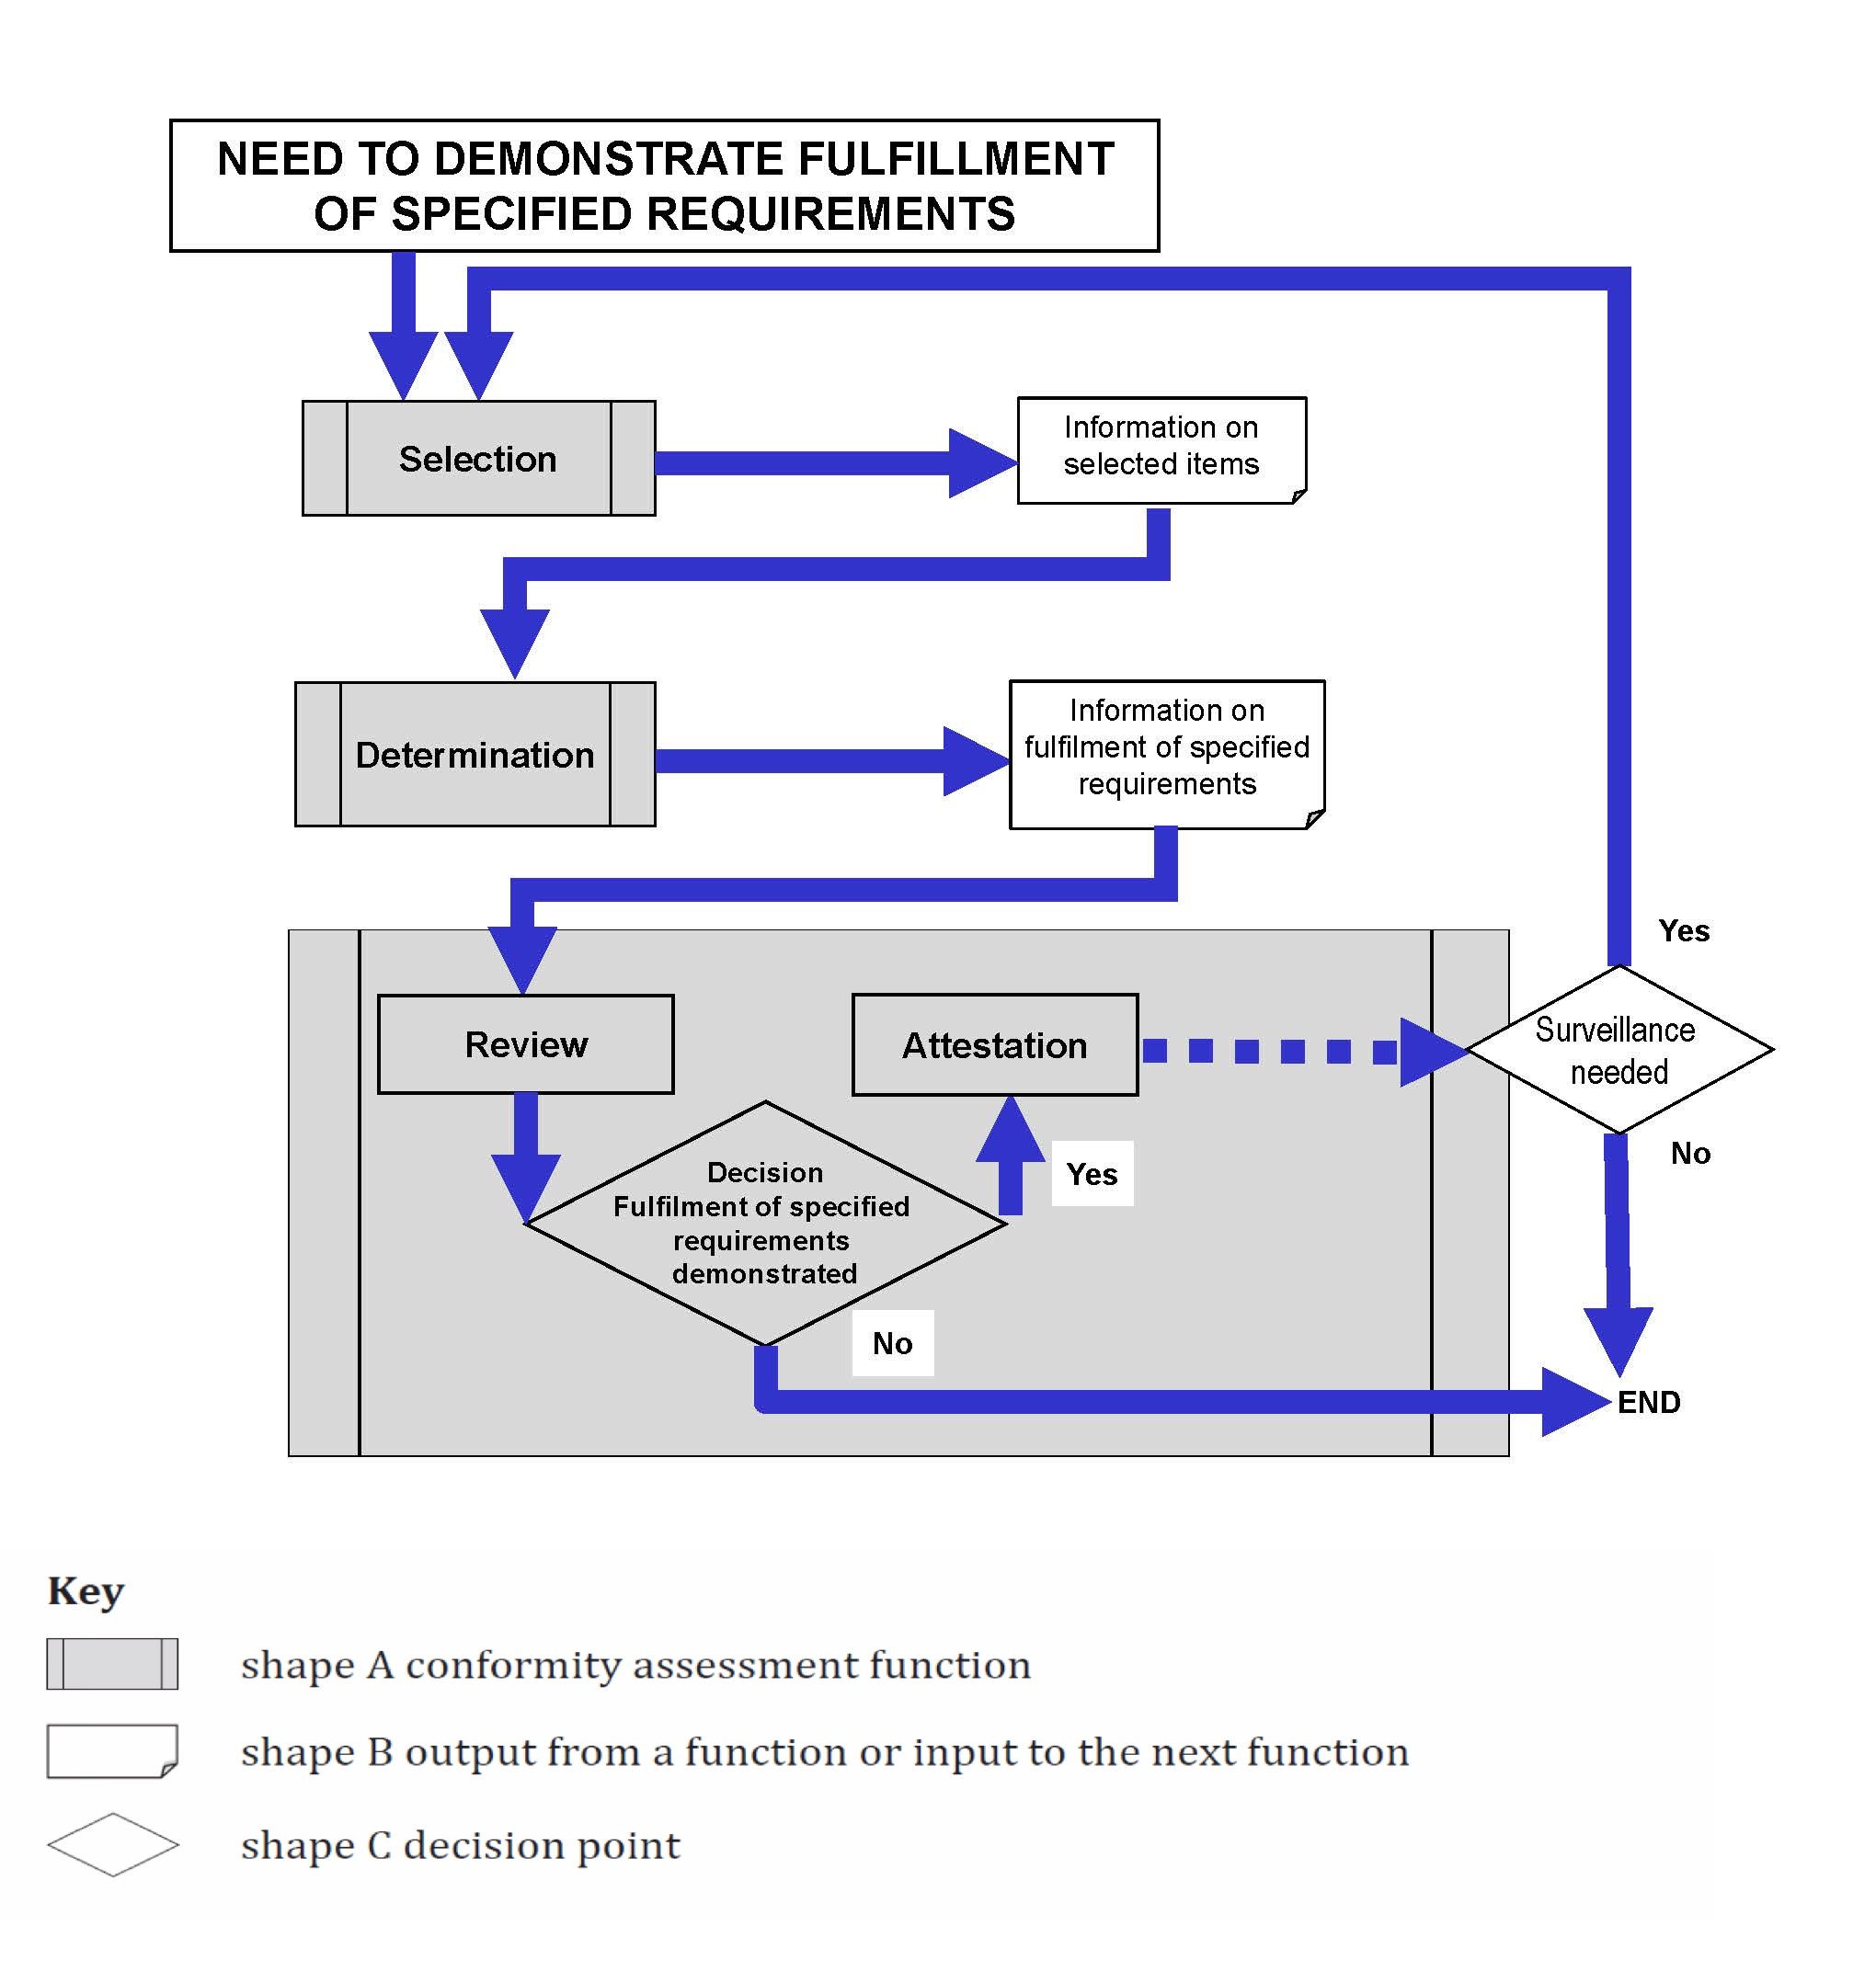
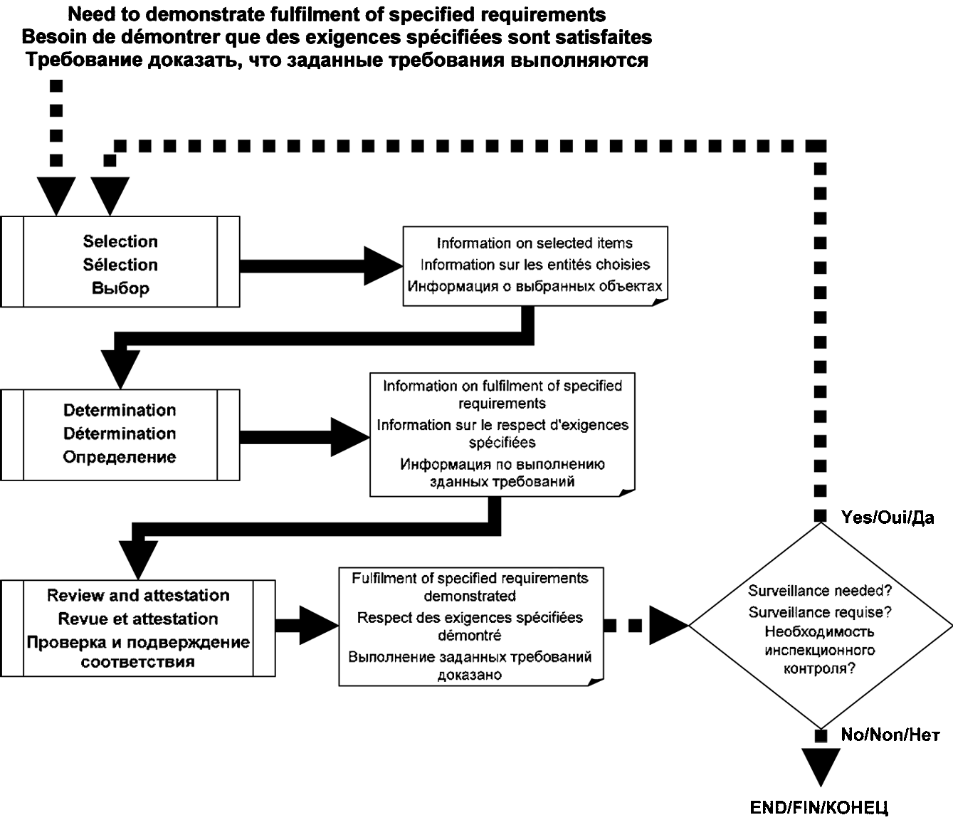
Functional Approach Changes
Original Functional Approach Diagram
Modified Functional Approach Diagram to add Decision

Slide 31
Annex B
B.1 contains related terms defined in other conformity assessment standards and the list of the standards where they can be found.
B.2 contains related terms defined in standards other than conformity assessment standards.

Slide 32
Thank you
The Co-Convenors of ISO CASCO Working Group 49 would like to thank the members of WG49 who worked diligently to reach consensus.
The Co-Convenors would also like to thank the ISO Secretariat including Mr. Sean MacCurtain and Ms. Anna Koroleva
Warm Regards,
Cynthia D. Woodley
Dandan Zheng

